Slide 1

INSTITUTE - UIE
DEPARTMENT- ACADEMIC UNIT-2
Bachelor of Engineering (Computer Science & Engineering)
Subject Name: Introduction to Problem Solving
Code:23CSH-101
Array & Strings
DISCOVER . LEARN . EMPOWER

Slide 2

OBJECTIVES
The course aims to provide exposure to problem solving with programming
The course aims to raise the programming skills of students via logic building capability
With the knowledge of C language students would be able to model real world problems
OBJECTIVES

Slide 3


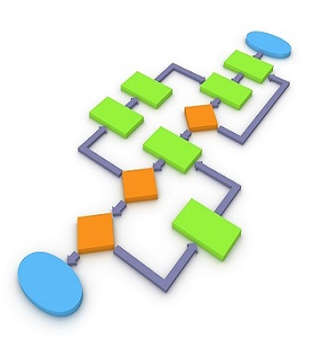
CO Number | Course Outcome
CO1 | Remember the concepts related to fundamentals of C language, draw flowcharts and write algorithm/pseudocode.
CO2 | Understand the way of execution and debug programs in C language.
CO3 | Apply various constructs, loops, functions to solve mathematical and scientific problem.
CO4 | Analyze the dynamic behavior of memory by the use of pointers.
CO5 | Design and develop modular programs for real world problems using control structure and selection structure.

Slide 4

Scheme of Evaluation

Slide 5
Content
Array
Types of Array
Declaration of one Dimensional Array
Initialization of one Dimensional Array
Examples
References

Slide 6
Array
In C programming, one of the frequently arising problem is to handle similar types of data.
For example: If the user want to store marks of 100 students. This can be done by creating 100 variable individually but, this process is rather tedious and impracticable. These type of problem can be handled in C programming using arrays.
An array is a sequence of data item of homogeneous value(same type).
All the data items of an array are stored in consecutive memory locations in RAM.
The elements of an array are of same data type and each item can be accessed using the same name.

Slide 7
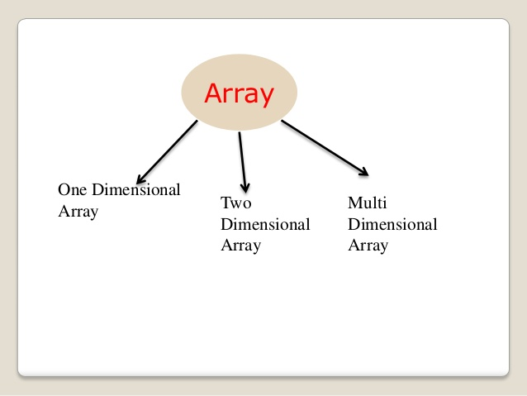
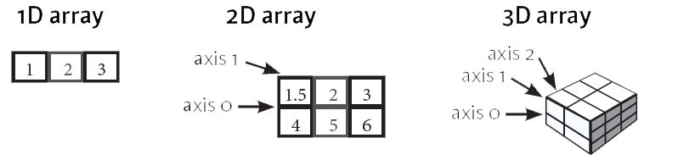
Array is of three types:
Types
of
Array

Slide 8
Declaration of one-dimensional array: We know that all the variables are declared before they are used in the program. Similarly, an array must be declared before it is used.
During declaration, the size of the array has to be specified. The size used during declaration of the array informs the compiler to allocate and reserve the specified memory locations.
data_type array_name[array_size]; For example:
int age[5]; Here, the name of array is age. The size of array is 5,i.e., there are 5 items(elements) of array age. All element in an array are of the same type (int, in this case).
Declaration of 1-D
Array

Slide 9
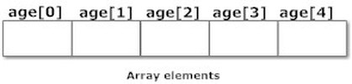
Each element of array can be accessed and used by user according to the need of program. For example: int age[5];
Array Elements
Note that, the first element is numbered 0 and so on. Here, the size of array age is 5 times the size of int because there are
5 elements. Suppose, the starting address of age[0] is 2120d and the size of int be 4 bytes.
Then, the next address (address of a[1]) will be 2124d, address of a[2] will be
2128d and so on.

Slide 10
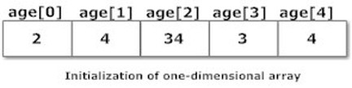
Initialization of one-dimensional array:
Arrays can be initialized at declaration time in this source code as: int age[5]={2,4,34,3,4}; It is not necessary to define the size of arrays during initialization. int age[]={2,4,34,3,4}; In this case, the compiler determines the size of array by calculating the number of elements of an array
Initialization 1-D Array

Slide 11
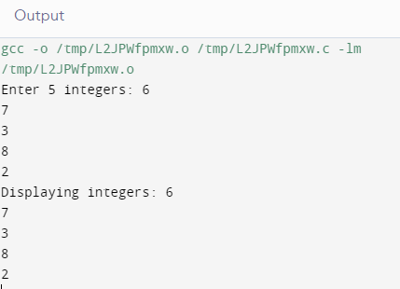
1. Program to take 5 values from the user and store them in an array.
#include<stdio.h>
int main()
{
int values[5];
printf("Enter 5 integers: ");
for(int i = 0; i < 5; ++i)
{
scanf("%d", &values[i]);
}
printf("Displaying integers: ");
for(int i = 0; i < 5; ++i)
{
printf("%d\n", values[i]);
}
return 0;
}
Examples of 1-D Array
Here, we have used a for loop to take 5 inputs from the user and store them in an array. Then, using another for loop, these elements are displayed on the screen

Slide 12
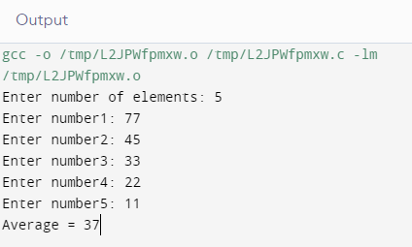
2. Program to find the average of n numbers using arrays
#include <stdio.h>
int main()
{
int marks[10], i, n, sum = 0, average;
printf("Enter number of elements: ");
scanf("%d", &n); for(i=0; i<n; ++i)
{
printf("Enter number%d: ",i+1);
scanf("%d", &marks[i]);
sum += marks[i];
}
average = sum/n;
printf("Average = %d", average);
return 0;
}
Examples of
1-D Array
Here, we have computed the average of n numbers entered by the user.

Slide 13
1.
Array is defined as an ordered set of similar data items
SUMMARY
2.
3.
During declaration of an array the size of the array has to be specified.
Arrays can be initialized at declaration time in this source code

Slide 14
FREQUENTLY ASKED QUESTIONS
PROGRAMS
Write a C Program to Addition of All Elements of the Array
Write a C Program to insert an element in an array.
Write a C Find Smallest Element in Array .
Write a C program to reversing an element in an array.
C program to find the sum and calculate percentage of marks of n students using arrays

Slide 15
UTILISE YOUR KNOWLEDGE TO ANSWER
1.What is the right way to initialize an array?
A.int num[6] = { 2, 4, 12, 5, 45, 5 };
B.int n{} = { 2, 4, 12, 5, 45, 5 };
C.int n{6} = { 2, 4, 12 };
D.int n(6) = { 2, 4, 12, 5, 45, 5 };
2. An array element is always stored in …………………..memory location?
A. Sequential
B. Random
C. Sequential and Random
D. None of the above
Let us see how much you have learned from the lecture and how effectively you can apply your knowledge…!!

Slide 16
UTILISE YOUR KNOWLEDGE TO ANSWER
3. Let x be an array. Which of the following operation are illegal?
I ++X
II X+1
III X++
IV X*2
A.I and II
B.I, II and III
C.II and III
D.I, III and IV
E.III and IV
4 Size of an array need not be specified, when
A. Initialization is a part of definition
B. It is a declaratrion
C. It is a formal parameter
D. All of these
Let us see how much you have learned from the lecture and how effectively you can apply your knowledge…!!

Slide 17

DISCUSSION FORUM
Q1 C Program to Delete duplicate elements from an array

Slide 18
REFERENCES
Book References:
[1] Kanetkar, Y. (2010). Let us C. 15th ed.
[2] Thareja Reema (2014) Programming in C. 2nd ed.
[3] Zed A. Shaw, Learn C the Hard Way’
[4] https://en.wikibooks.org/wiki/C_Programming
Vedio Lecture: https://nptel.ac.in/courses/106/106/106106127/
https://nptel.ac.in/courses/106/105/106105171/
https://study.com/academy/lesson/declaring-one-dimensional-arrays-definition-example.html
https://www.youtube.com/watch?v=XZGZm-0wUC0
Websites: https://www.cs.swarthmore.edu/~newhall/unixhelp/C_arrays.html
https://beginnersbook.com/2014/01/c-arrays-example/
https://www.codesdope.com/c-array/
BOOKS
WEBSITES
COURSES

Slide 19

THANK YOU

